Slide 1
LAPLACE TRANSFORM.
The Laplace transform is an integral transformation of a function f (t) from the time domain into the complex frequency domain, giving F(s).
The table below show the important properties of Laplace transform.

Slide 2
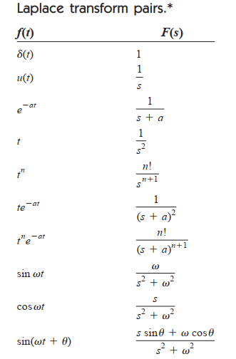

Slide 3
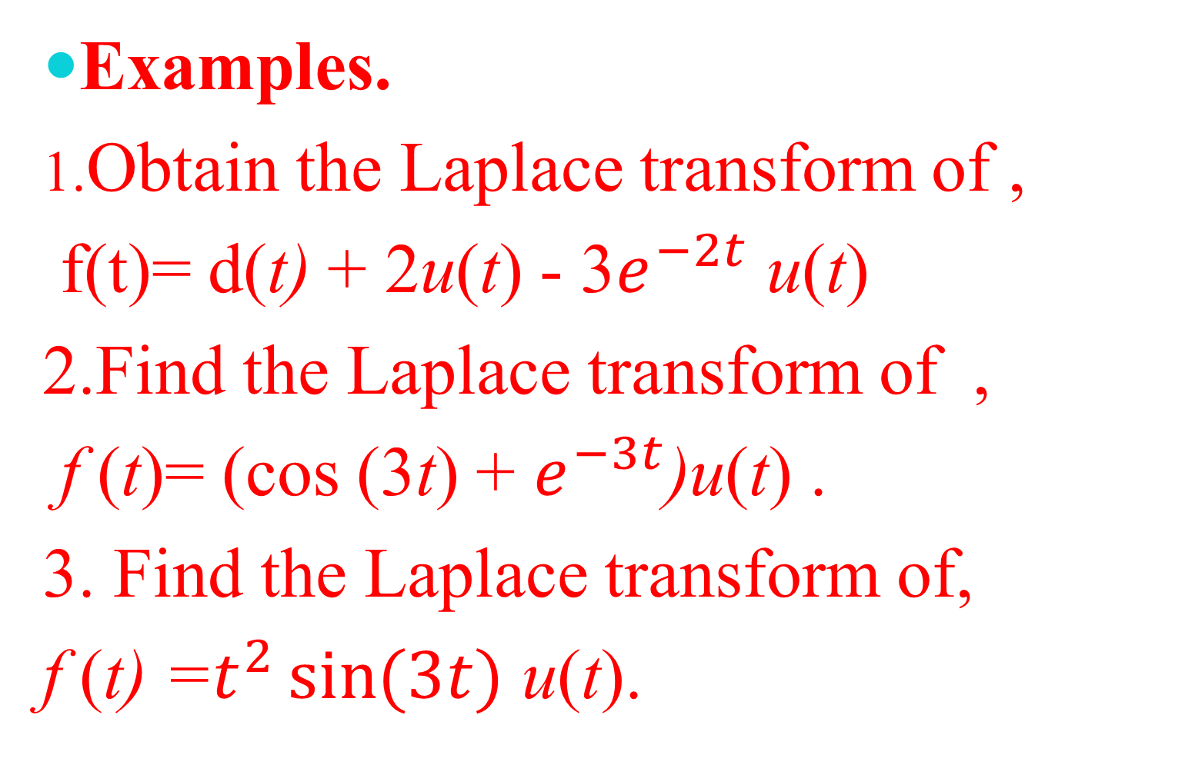
Examples.
1.Obtain the Laplace transform of ,
f(t)= d(t) + 2u(t) - 3$e^{−2t}$ u(t)
2.Find the Laplace transform of ,
f (t)= (cos (3t) + $e^{−3t}$)u(t) .
3. Find the Laplace transform of,
f (t) =$t^{2}\sin{(3t)}$ u(t).

Slide 4
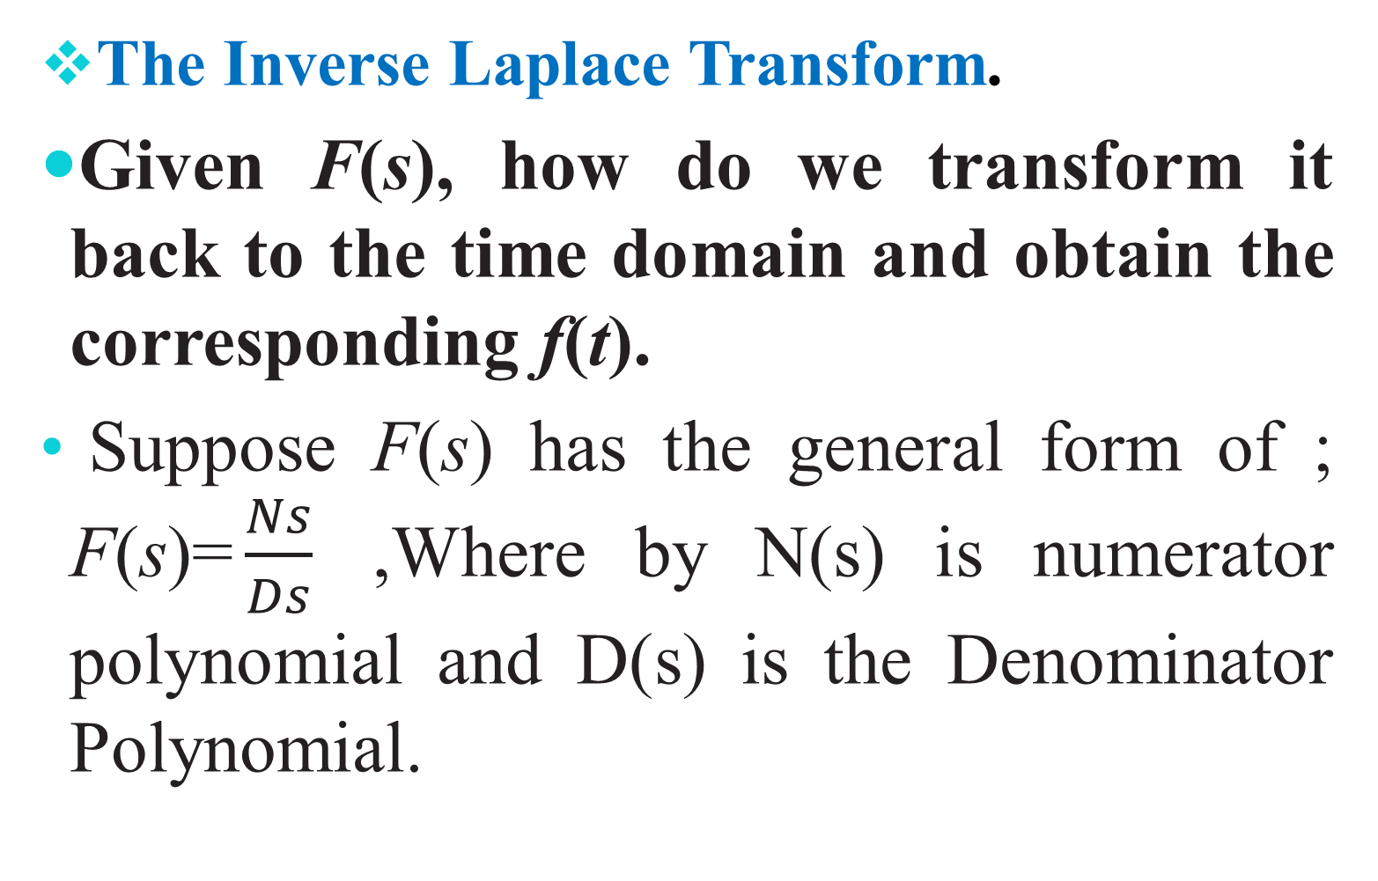
The Inverse Laplace Transform.
Given F(s), how do we transform it back to the time domain and obtain the corresponding f(t).
Suppose F(s) has the general form of ; F(s)=$\frac{Ns}{Ds}$ ,Where by N(s) is numerator polynomial and D(s) is the Denominator Polynomial.

Slide 5
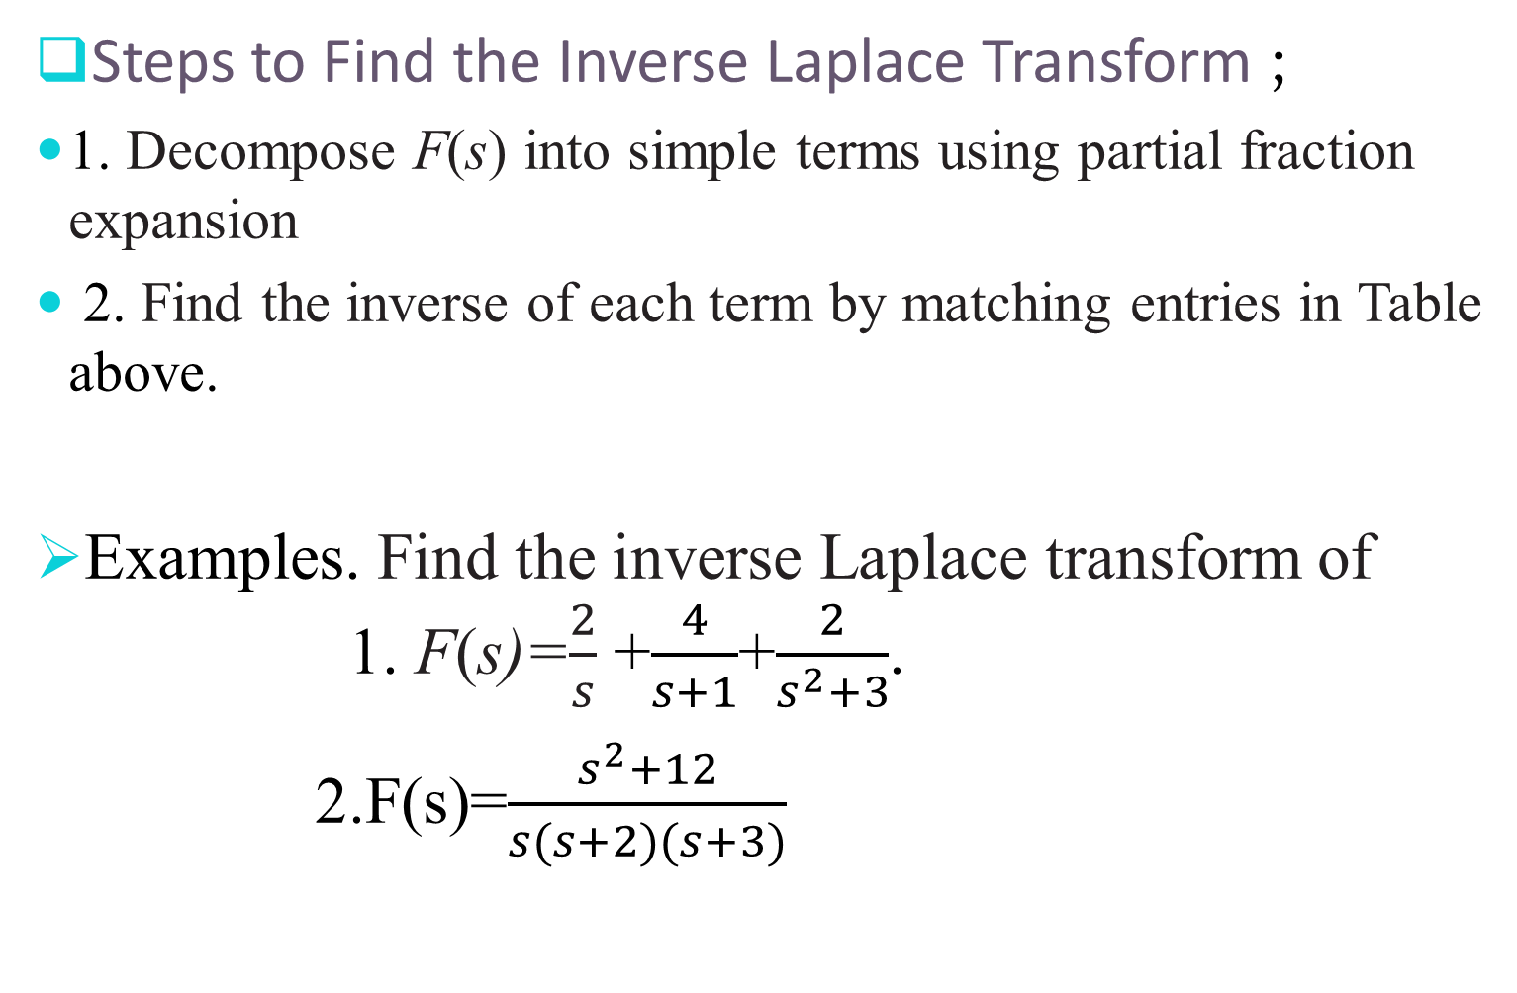
Steps to Find the Inverse Laplace Transform ;
1. Decompose F(s) into simple terms using partial fraction expansion
2. Find the inverse of each term by matching entries in Table above.
Examples. Find the inverse Laplace transform of 1. F(s)=$\frac{2}{s}$ +$\frac{4}{s+1}$+$\frac{2}{s^{2}+3}$.
2.F(s)=$\frac{s^{2}+12}{s(s+2)(s+3)}$

Slide 6
Applications of the Laplace Transform.
The Laplace transform help to examine and to analyze network stability and network synthesis.
Steps in Applying the Laplace Transform in electrical circuit Element ;
1.Transform the circuit from the time domain to the s-domain.
2. Solve the circuit using nodal analysis, mesh analysis, source
transformation, superposition, or any circuit analysis technique
with which we are familiar.
3. Take the inverse transform of the solution and thus obtain the
solution in the time domain.

Slide 7
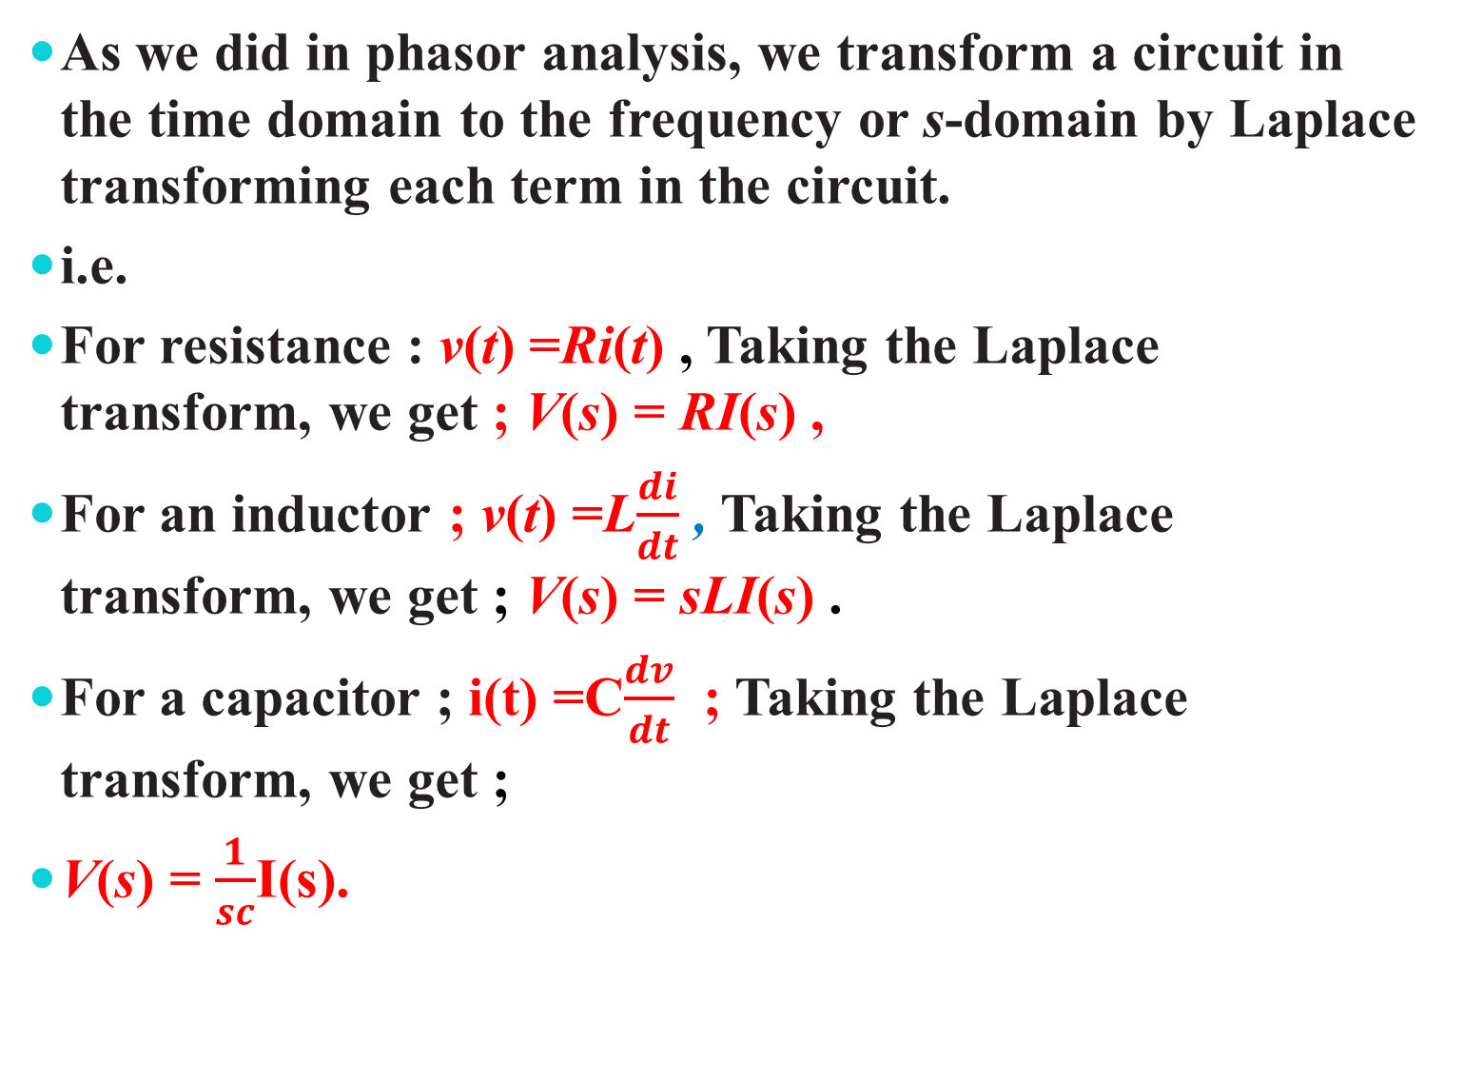
As we did in phasor analysis, we transform a circuit in the time domain to the frequency or s-domain by Laplace transforming each term in the circuit.
i.e.
For resistance : v(t) =Ri(t) , Taking the Laplace transform, we get ; V(s) = RI(s) ,
For an inductor ; v(t) =L$\frac{di}{dt}$ , Taking the Laplace transform, we get ; V(s) = sLI(s) .
For a capacitor ; i(t) =C$\frac{dv}{dt}$ ; Taking the Laplace transform, we get ;
V(s) = $\frac{1}{sc}$I(s).

Slide 8
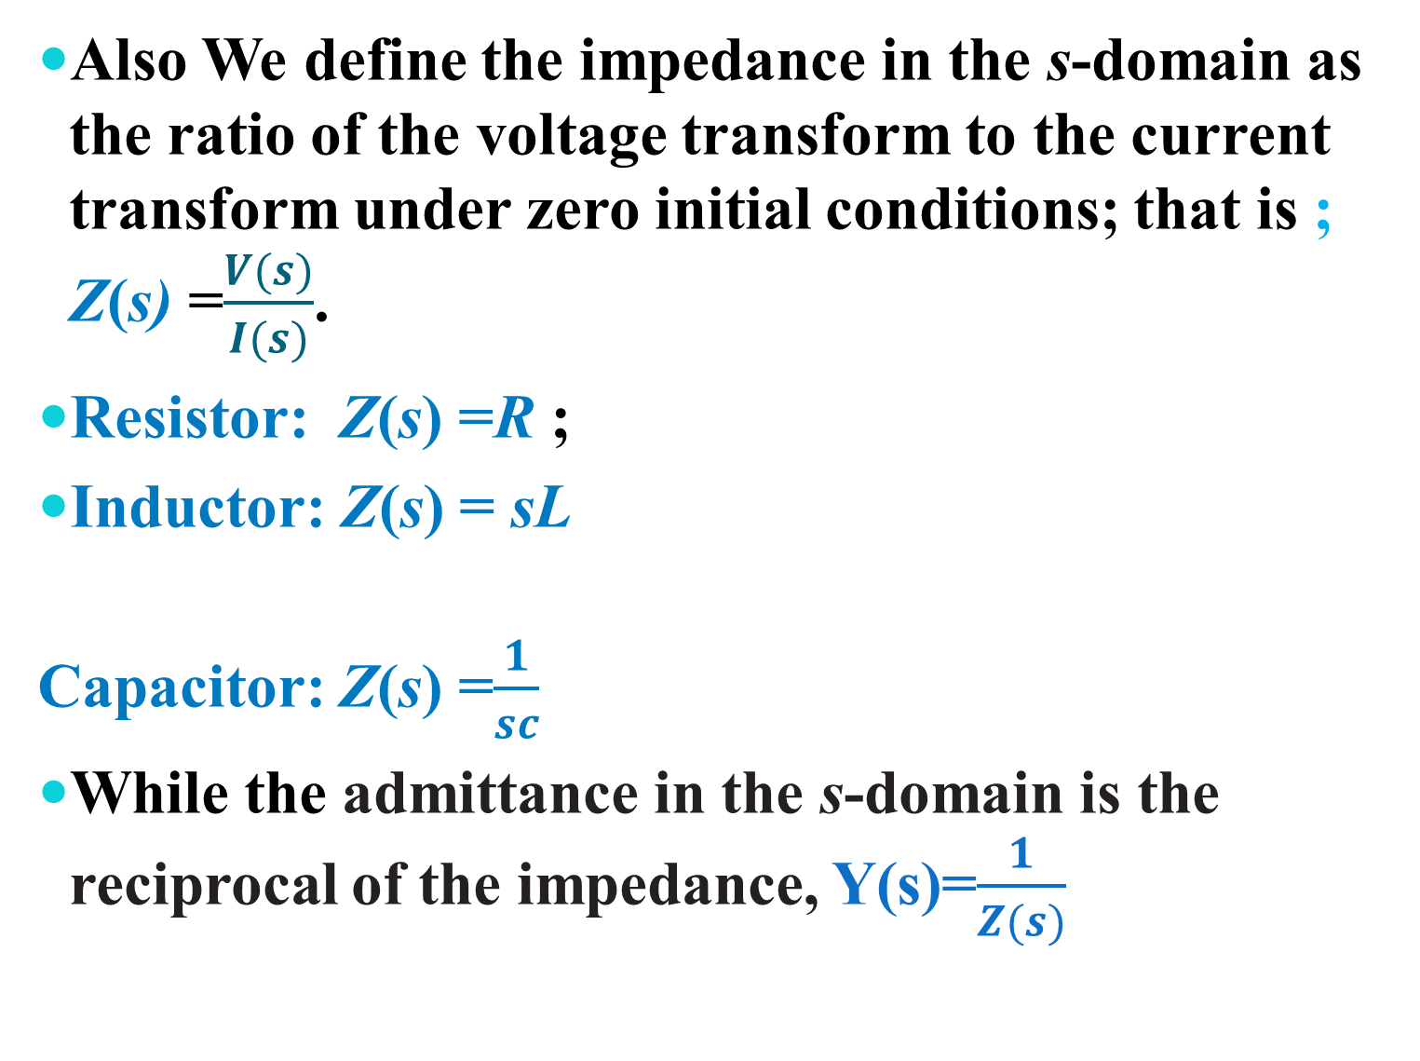
Also We define the impedance in the s-domain as the ratio of the voltage transform to the current transform under zero initial conditions; that is ; Z(s) =$\frac{V(s)}{I(s)}$.
Resistor: Z(s) =R ;
Inductor: Z(s) = sL
Capacitor: Z(s) =$\frac{1}{sc}$
While the admittance in the s-domain is the reciprocal of the impedance, Y(s)=$\frac{1}{Z(s)}$

Slide 9
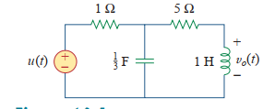
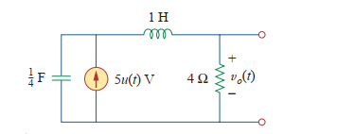

Examples;
1.Find ${Vo}_{t}$ assuming zero initial condition;
Determine ${Vo}_{t}$ .

Slide 10
………………THE END OF LECTURE THREE………..
THANK you!!!!!!!!!!!

